Slide 1
Overview of course | Powerpoint
Powerpoint | Microscopes
Powerpoint and revision | Powerpoint
Test | Powerpoint

Slide 2
Characteristics of Life
Unit One: Healthy Body

Slide 3
Resources
CK-12 (website and app)
Squiz (app)
BYJU’s (website and app)
Khan Academy (website and app)
How stuff works (website)

Slide 4
Curriculum Point
All living things carry out the life processes of respiration, feeding (including digestion and absorption), excretion, movement, reproduction, responding to stimuli and growth.

Slide 5
Assessment
Test on Life Processes
4% of total mark
Includes multiple choice (13 questions), short answer (3 questions) and extended answer (1 question)
Total time 30 minutes

Slide 6
Connections
Year 7 Biology- MRS GREN
Movement, Respiration, Sensitivity, Growth, Reproduction, Excretion, Nutrition
An organisms needs to check all seven boxes for it to be classified as living

Slide 7
Respiration
Respiration is the conversion of energy from carbohydrates (the sugars, starches and fibres found in fruits, grains, vegetables and milk products) and fats into energy that can be used by cells.
In multicellular organisms, respiration is built around the breakdown of sugars with the use of oxygen. This produces carbon dioxide as a by-product.
Some micro-organisms, in areas where there is little oxygen, use other molecules such as nitrates and iron, to help break down sugars.

Slide 8
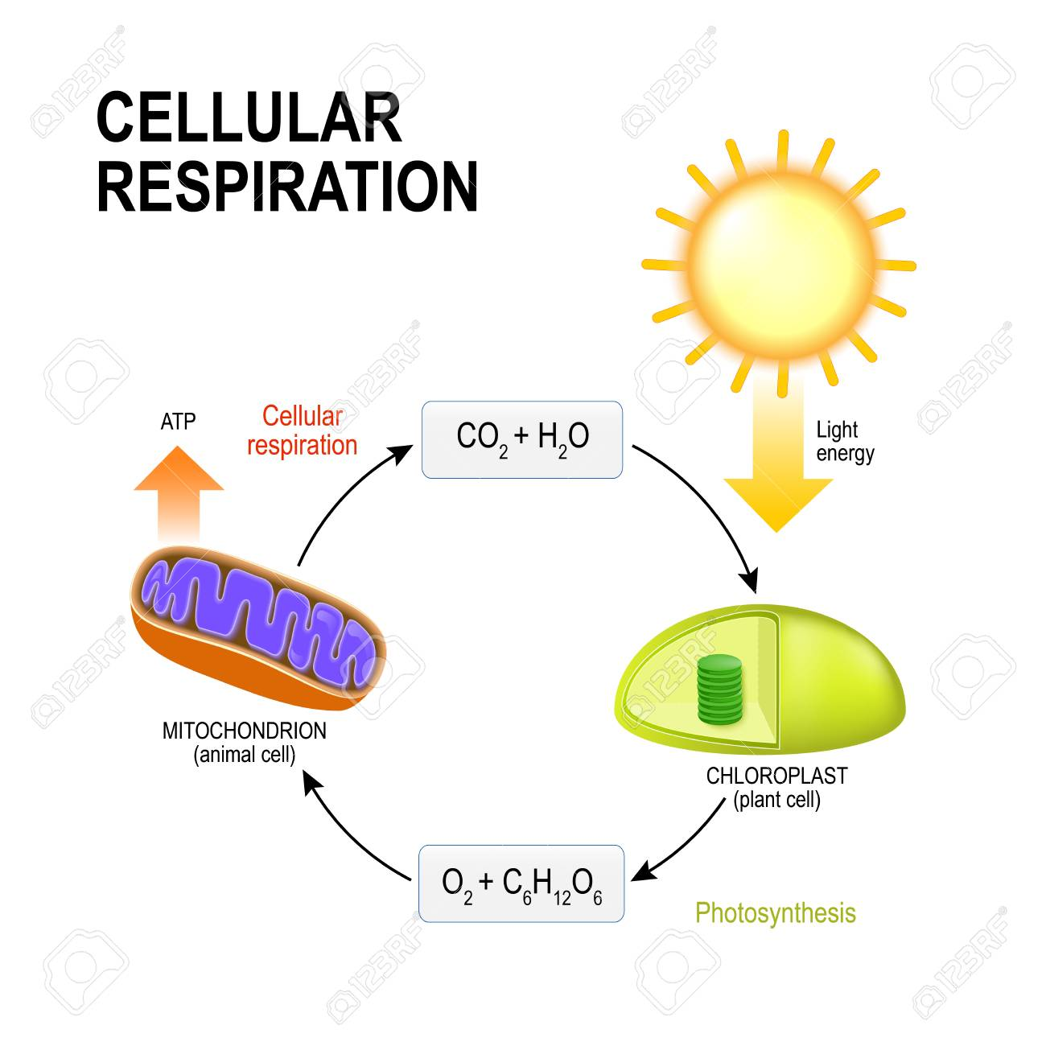

Slide 9
Feeding (digestion and absorption)
Nutrition: in order for organisms to survive they require food for energy and nutrients.
Absorption: The transfer of substances into cells, tissues, or organs.
Digestion: The mechanical and chemical breakdown of food to small molecules that can be absorbed into the body.

Slide 10
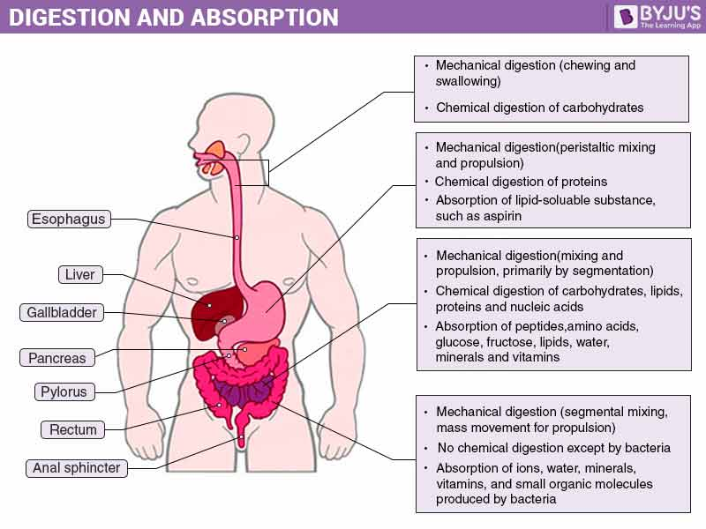

Slide 11
Excretion
Normal functions in cells and tissues of organisms produce waste such as urine and dead cells. If waste products aren’t removed, they can become toxic. Excretion is the term used to define the removal of waste products from an organism (urine, poo, sweat).

Slide 12
Movement
A living organism will always have some degree of movement, be it their entire body or particular body parts.
Organisms that are not able to move freely (plants) will usually have strong defenses against predation.

Slide 13
Reproduction
All living things reproduce to ensure the next generation. Organisms that do not reproduce will go extinct.
Some organisms reproduce asexually (especially single-celled organisms) and make identical copies of themselves using a process called mitosis.
Other organisms reproduce sexually, combining genetic information from two parents to make genetically unique offspring (meiosis).

Slide 14
Responding to stimuli
Refers to the way organisms respond to their environment by sensing changes and acting accordingly.
For example, barnacles will close their shells during low tide to prevent themselves drying out.
Organisms constantly respond to changes in light, heat, sound, and chemical and mechanical contact (Homeostasis). Organisms have means for receiving such information, such as eyes, ears, taste buds and skin.

Slide 15
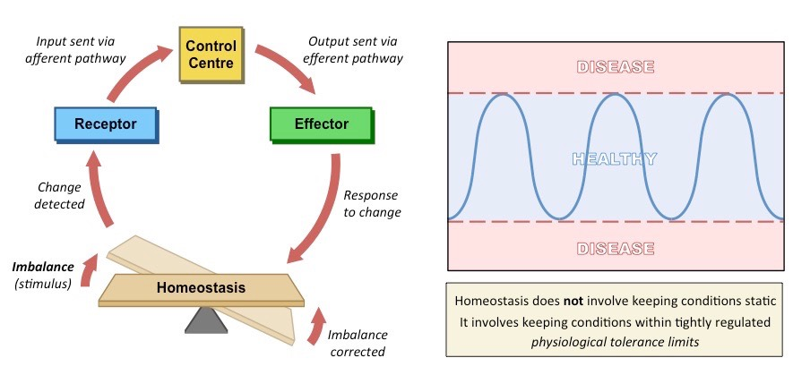

Slide 16
Growth
The increases in cell size and number that take place during the life history of an organism.
Growth occurs according to a plan that eventually determines the size and shape of the individual.
The predetermined pattern of growth in plants and animals can be seen in the forms of adults.
In some organisms, however, notably the slime molds, no regular pattern of growth occurs, and a formless cytoplasmic mass is the result.

Slide 17
Revision Questions
1) Why is movement essential to an organism?
2) What do we call the process by which plants use energy from the sun to get nutrition and energy?
3) What is homeostasis?
4) How does your body retain or lose heat? Explain.

Slide 18
Curriculum Point
The cell theory states that all cells arise from other living cells.

Slide 19
History
Biologists in the early part of the 19th century suggested that all living things were made of cells. It wasn’t until 1839 that it was suggested that all living things were made of cells and that cells were the basic unit of structure and function of all living things.
In 1858 cells were observed dividing and it was proposed that all cells arise only from other cells. These observations formed the rules of the cell theory.

Slide 20
The Rules of the Cell Theory
1) All organisms are made up from one or more cells
2) All the life functions of an organism occur within cells
3) All cells come from pre-existing cells

Slide 21
Cells
Cells come in many shapes and sizes and all have a function. The shapes and sizes directly influence the function of the cell.
For example, the nerve cell has many long extensions so it is able to pass messages along to other nerve cells.

Slide 22
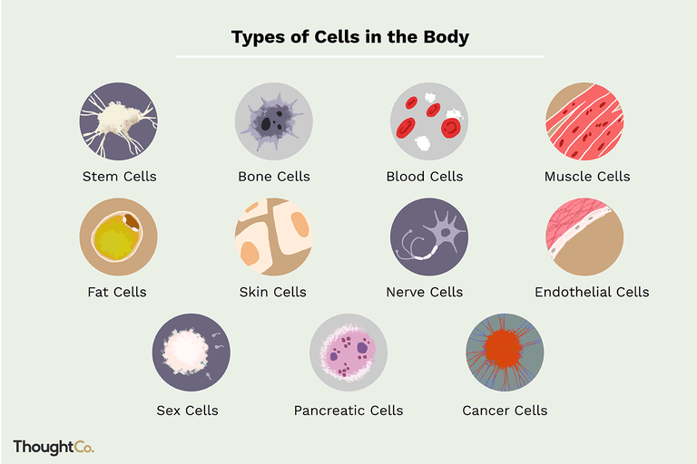

Slide 23
Curriculum Point
Cells are separated from their surroundings by the cell membrane, which controls the movement of materials into and out of the cell by:
  Passive processes, including diffusion and osmosis
  Active processes, including active transport, endocytosis

Slide 24
Cell Membrane
Is the barrier to separate the inside from the outside of the cell.
It is semi- permeable with a double layer of phospholipids.

Slide 25
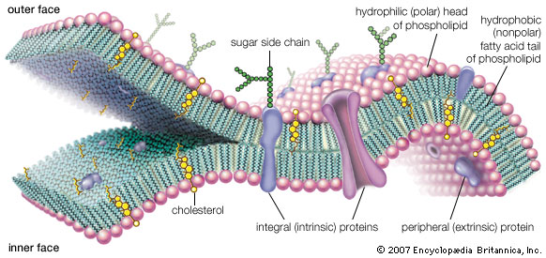

Slide 26
Diffusion
Is the movement of a substance from an area of high concentration to an area of low concentration.

Slide 27
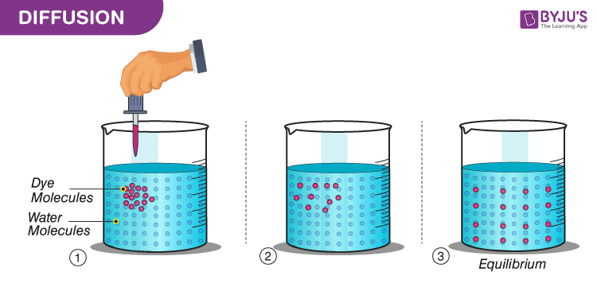
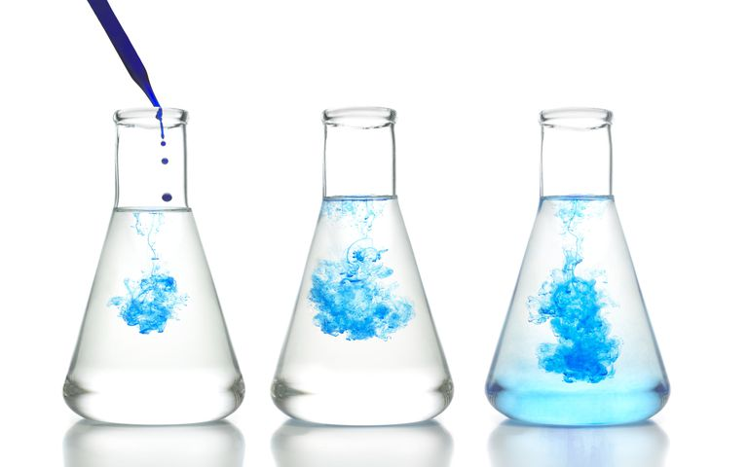

Slide 28
Osmosis
A process by which molecules of a solvent tend to pass through a semipermeable membrane from a less concentrated solution into a more concentrated one.

Slide 29
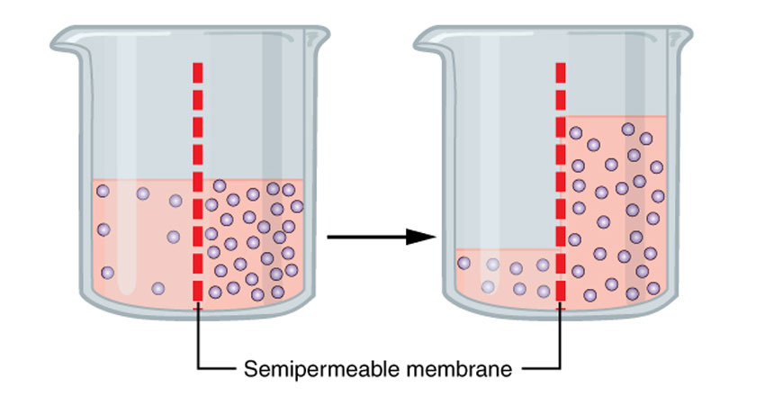

Slide 30
Active Transport
The movement of ions or molecules across a cell membrane into a region of higher concentration, assisted by enzymes and requiring energy

Slide 31
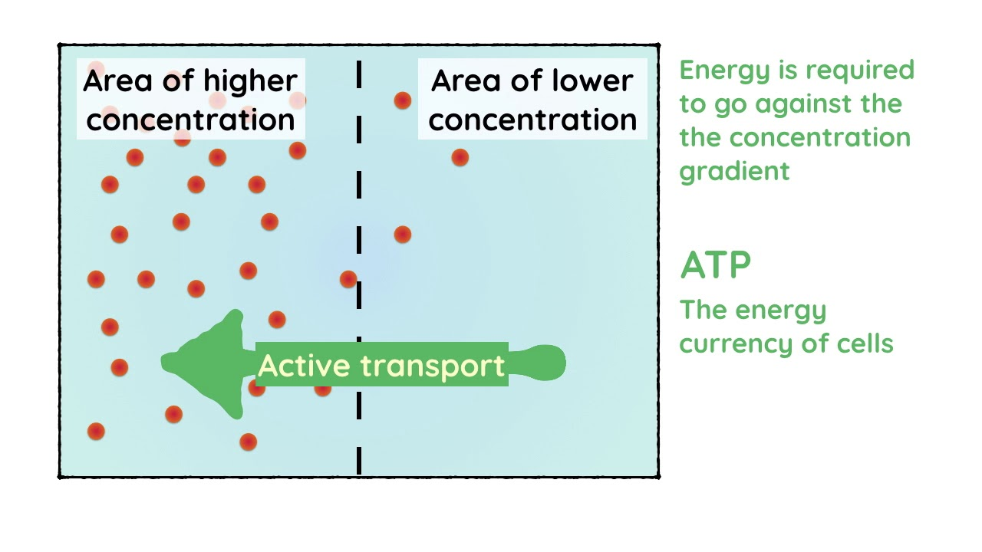

Slide 32
Endocytosis
The taking in of matter by a living cell by invagination of its membrane to form a vacuole

Slide 33
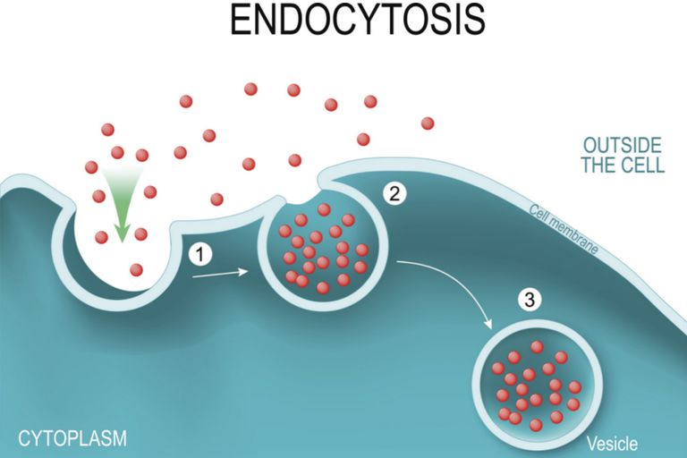

Slide 34
Curriculum Point
Body cells contain specialised structures with specific functions, including nucleus, mitochondria, ribosomes, lysosomes and cytoplasm

